Slide 1
World Food Safety Day 2021
Safe food now for a healthy tomorrow

Slide 2
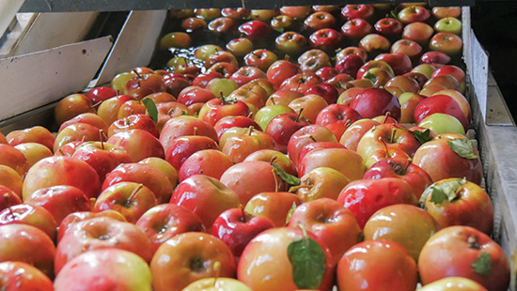
Our Objectives
World Food Safety Day (WFSD) celebrated on 7 June 2021 aims to draw attention and inspire action to help prevent, detect and manage foodborne risks, contributing to food security, human health, economic prosperity, agriculture, market access, tourism and sustainable development.
Calls to action:
Ensure it’s safe
Grow it safe
Keep it safe
Know what's safe
Team up for food safety
Hygiene and cleanliness are more important to customers than choice of food, value for money, service and location when choosing a restaurant*. Whilst poor hand hygiene is responsible for a large proportion of foodborne illness there is much more to food safety than hand hygiene.
At Ecolab we support customers clean kitchens, serving 58 billion restaurant meals every year, and prevent more than
7.5 million food born illnesses
FOOD
*study carried out in the UK by Peach Brand Track, Demographix/Toluna, November 2011. (5,000 strong sample).

Slide 3
A PERSISTENT THREAT
Restaurants are a primary source of foodborne illness, which, beyond the negative health consequences, can lead to shutdowns, significant fines and brand damage that can be hard to recover. WHO data found that overall in the European Region,
diarrheal diseases were responsible for 94% of foodborne illnesses, 63% of deaths and 57% of the burden. WHO says that restaurants and canteens account for 40% of the total amount of outbreaks.
More than
80%
of foodborne illnesses
originate in foodservice settings.¹
Restaurants and canteen account for
40%
of the total amout of
outbreaks.²
The emergence of COVID-19 has created additional risks for foodservice operations, resulting in an increased focus on cleanliness and sanitation.
¹ THE BURDEN OF FOODBORNE DISEASES IN THE WHO EUROPEAN REGION
²The European Union summary report on trends and sources of zoonoses, zoonotic agents and food-borne outbreaks

Slide 4
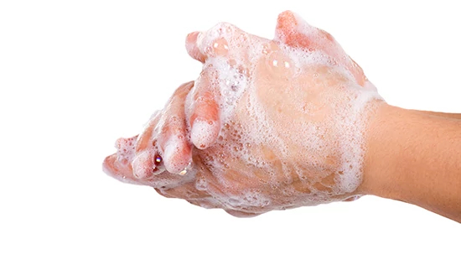
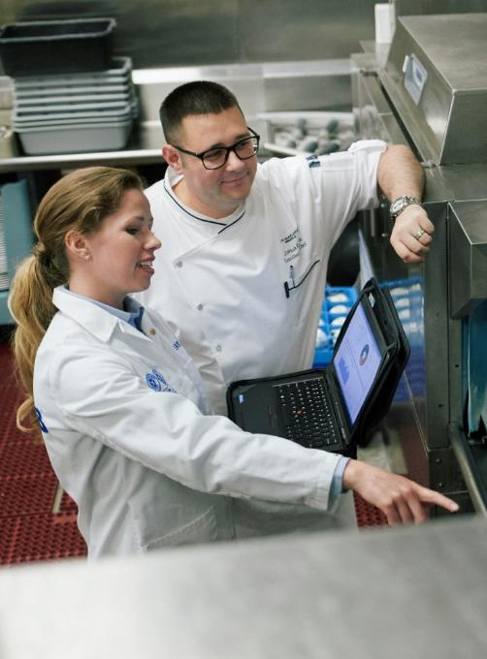
consider implementing some of these BEST PRACTICES
Make hand washing convenient
Proper hand washing can be one of the best preventive measures you institute at your restaurant. Making hand washing easy for employees and incorporating it into the flow of food preparation can help you ensure that everyone has proper hand hygiene top of mind.
Handwashing:
The best of all preventive measures
Ensure proper cooler temperature control
Regularly verifying your cooler’s internal temperature is critical. Setting your refrigerator to the proper temperature — the refrigerator should be at 4,5 °C or below and the freezer at -18 °C or below — is a first step.
Know your vendors and suppliers
There are times when a potential contamination originates upstream. That is why it is important to know:
what type of food safety practices are in place
that their practices are up to code
your vendors and suppliers

Slide 5
REMemBER TO Clean, clean, clean… and disinfect
Your strongest defense for food safety is a good offense, which means instituting regular cleaning with proper products for the surface and food soil.
After cleaning food contact surfaces use an EN NORMS-registered hard surface food contact surface disinfectant.
Be sure to clean high-touch surfaces and items such as door handles, menus and chairs or booths
Most importantly, read product labels, implement local best practices and mitigate risks in case of a foodborne illness incident.
A strategic partnership with vendors like Ecolab can assist in identifying the right products, tools, processes and on-site training to ensure a properly implemented and executed food safety program.
To learn more about Food safety and the personalized service of Ecolab, contact us.
Food Safety Matters | Ecolab: https://en-uk.ecolab.com/pages/food-safety-matters

